Slide 1
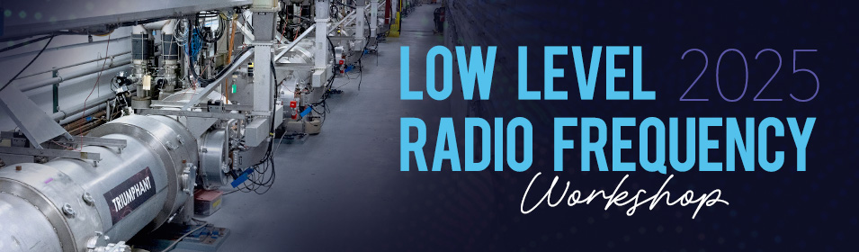
Fermilab Update
P. Varghese
13 October 2025

Slide 2
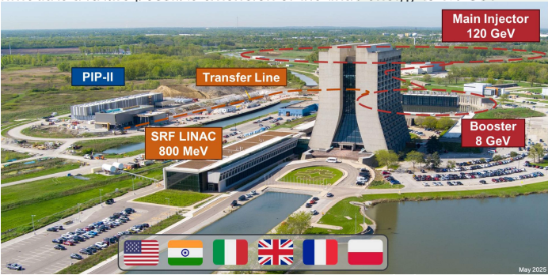
Fermilab Accelerator Complex
Project received DOE CD-3 approval in 2022
LLRF System final design review in 2024
Production stage
2025/26
Upgrades for Booster and Main Injector for higher beam power

Slide 3
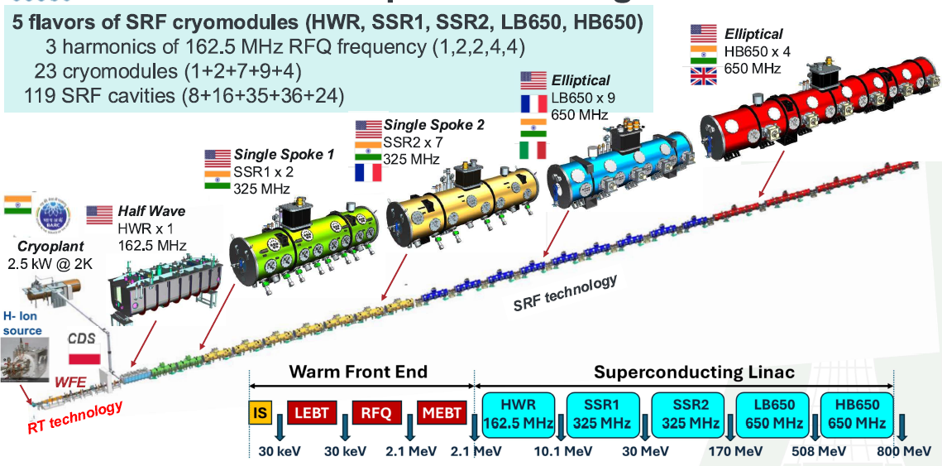
PIP-II 800 MeV Superconducting RF CW Linac

Slide 4
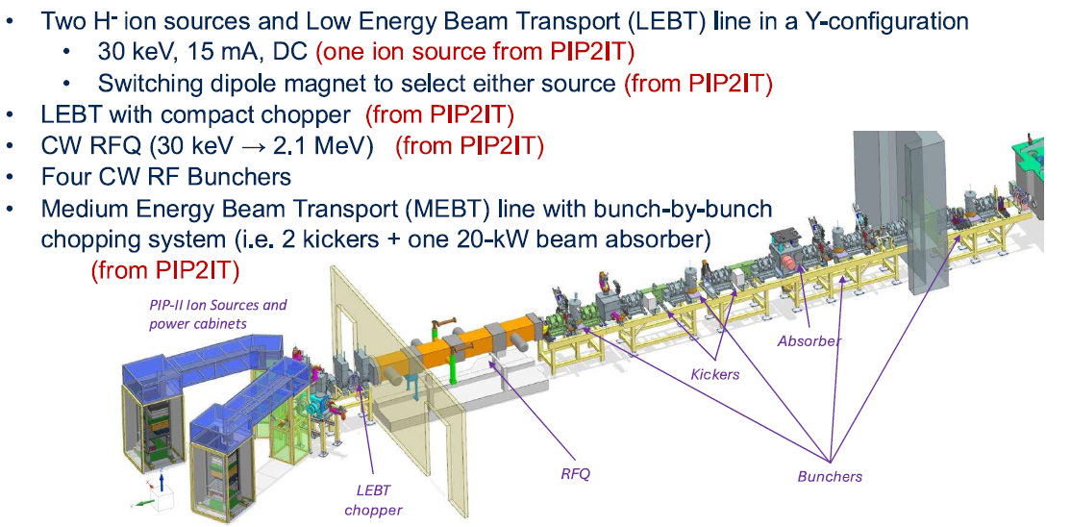
PIP-II Warm Front End
LLRF system for RFQ, Bunchers and HWR is being upgraded – Poster 23
The Beam Pattern Generator drives the kickers and controls transfer to Booster – Poster 21

Slide 5
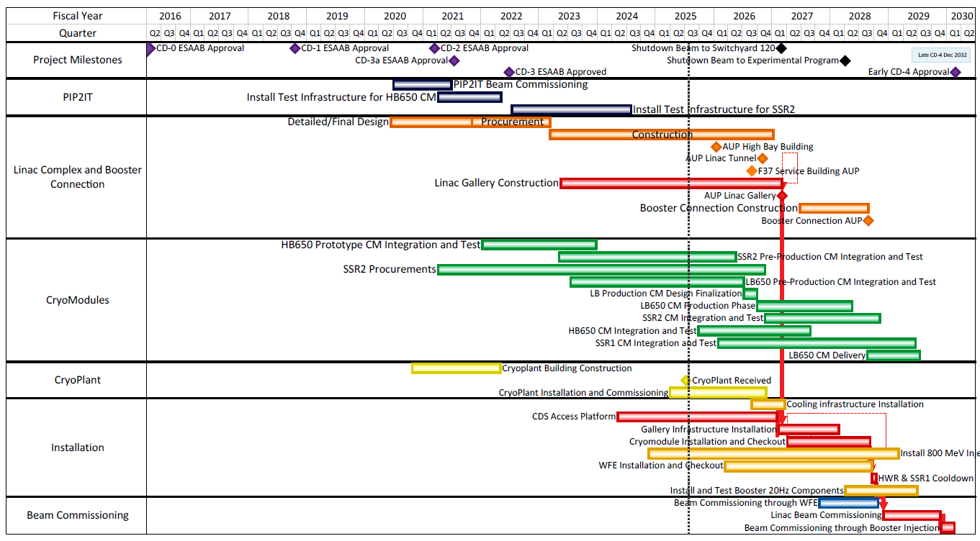
PIP-II Project Schedule

Slide 6
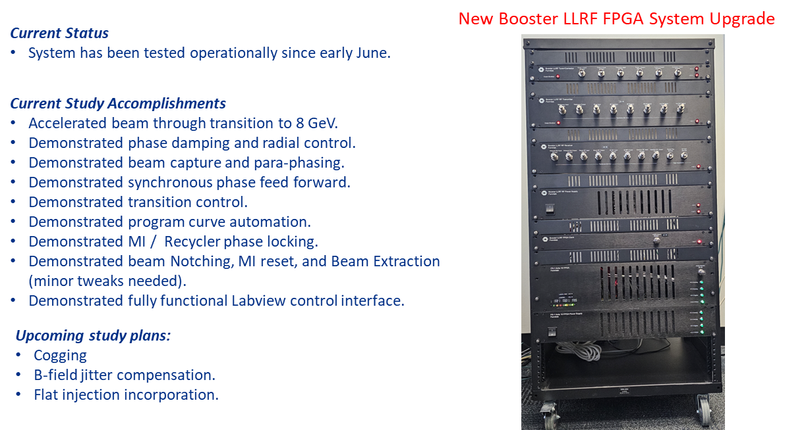
Booster Upgrades

Slide 7
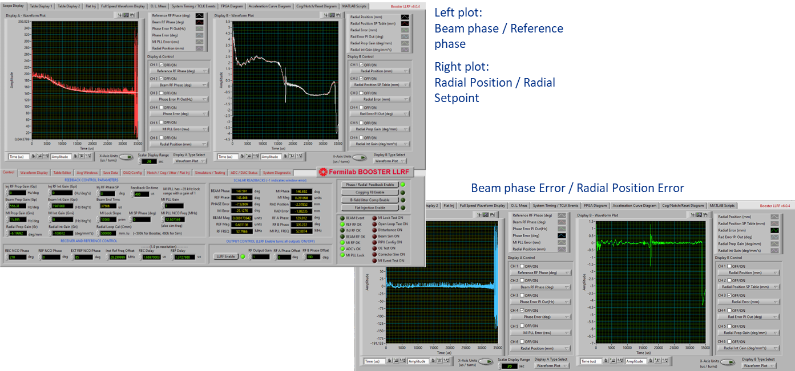
Booster Studies

Slide 8
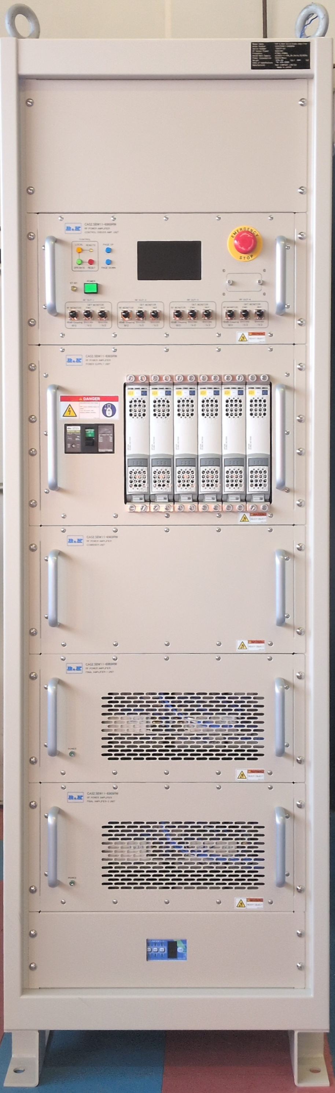
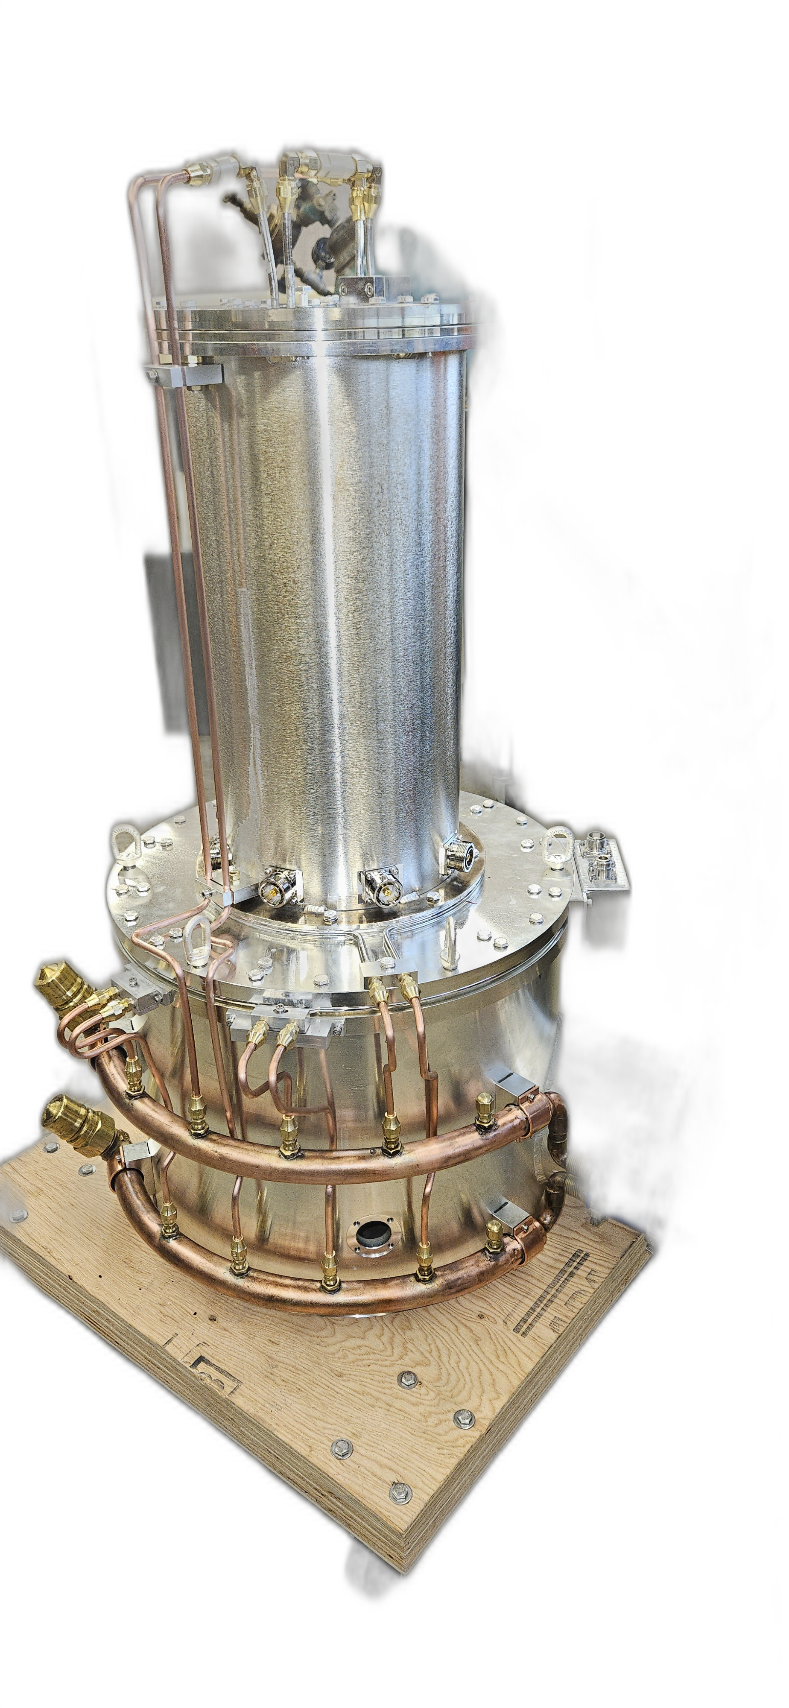
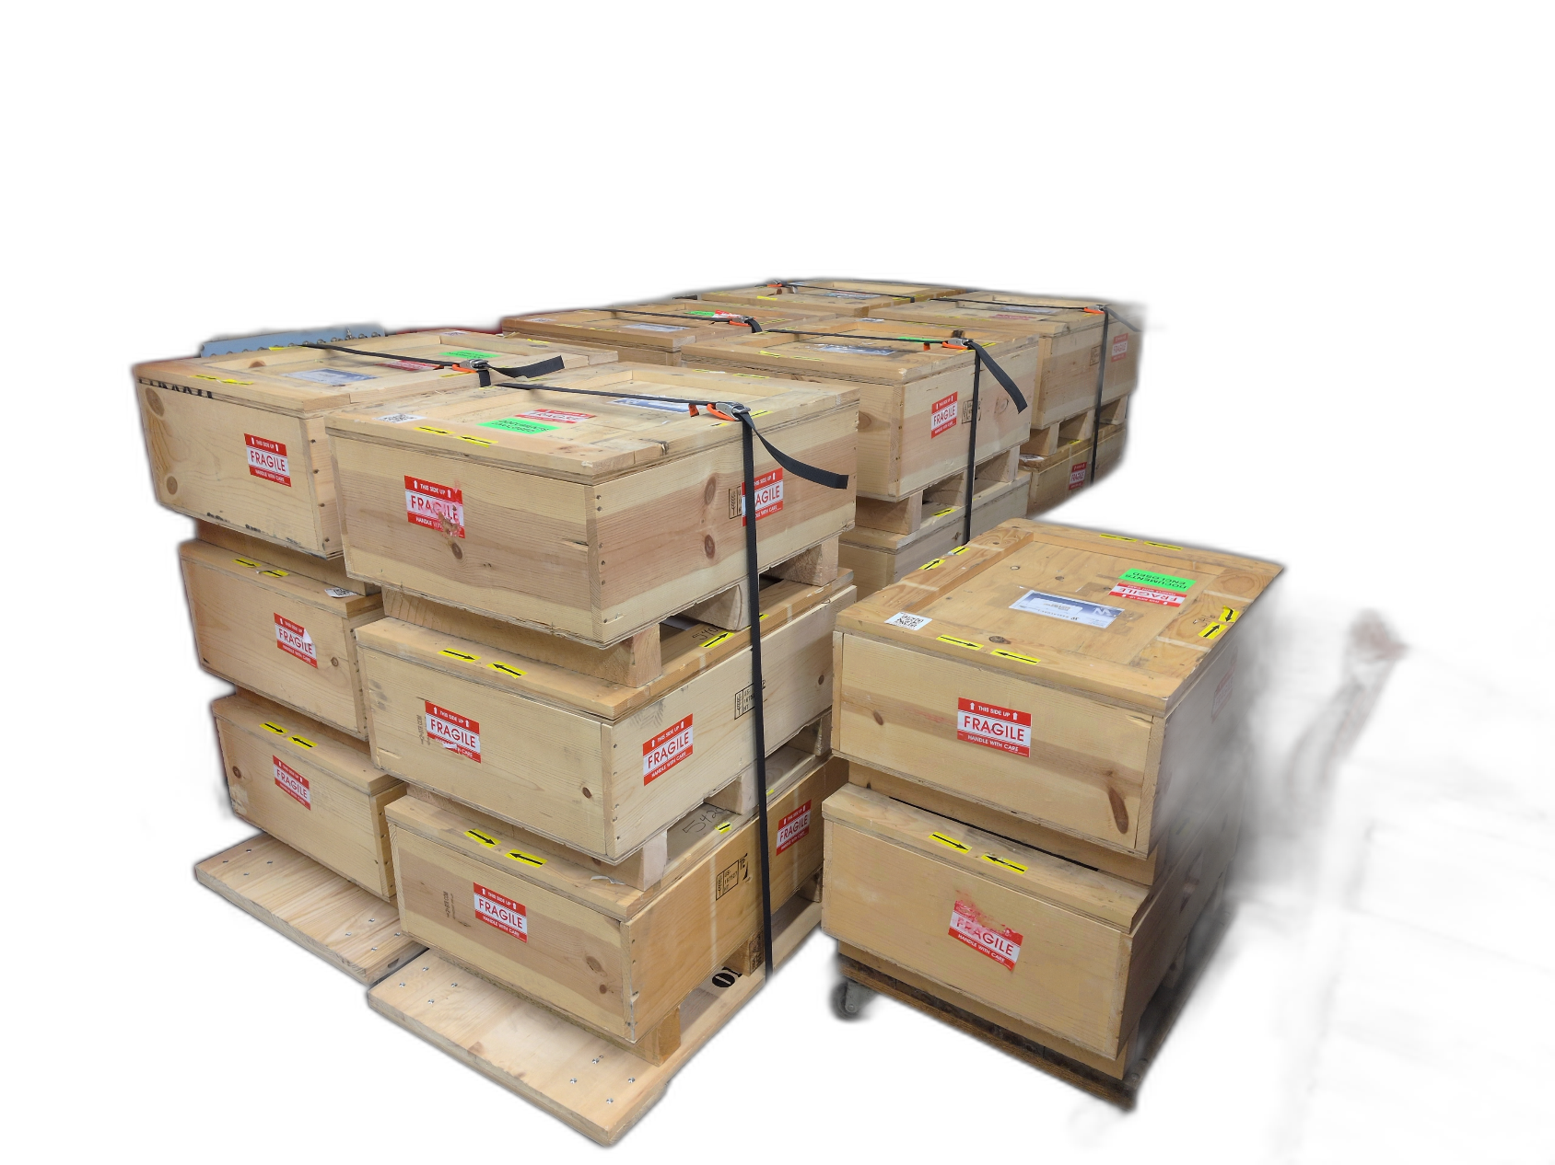
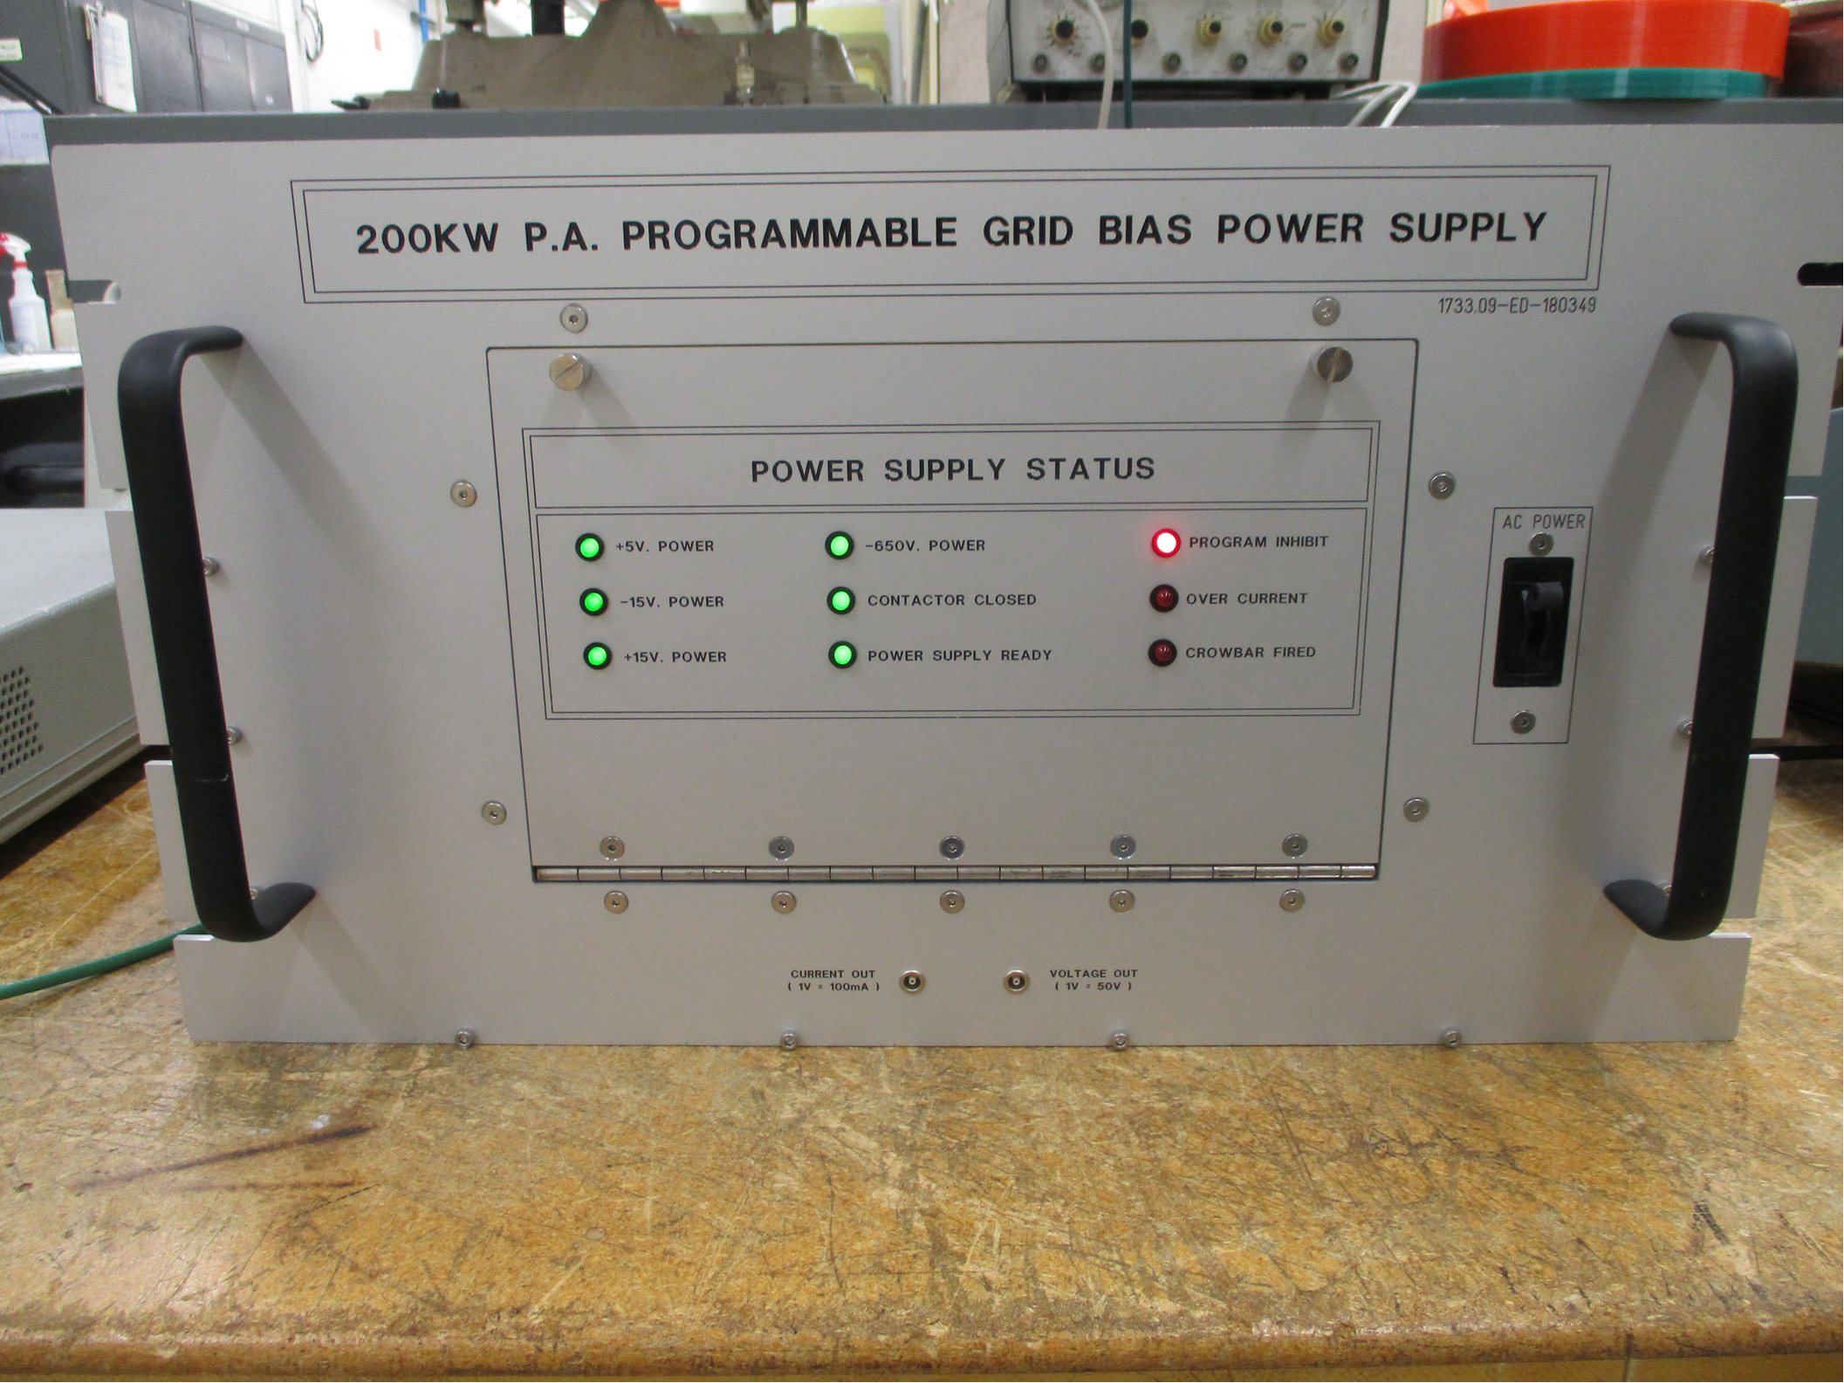
Main Injector Upgrades
14 of 20 stations have all necessary cables pulled
First article of twenty 8kW solid state amplifier received
Expect 2 per Month from October 2025 - May 2026
All 20 of the 8 to 4 way combiners received
Constructing new Grid Bias Power Supplies
Built 8 of 40 new Y567B Cavity Power Amplifiers
Oct. 8, 2025
David Ziliak | PIP-II 2025 DOE IPR

Slide 9
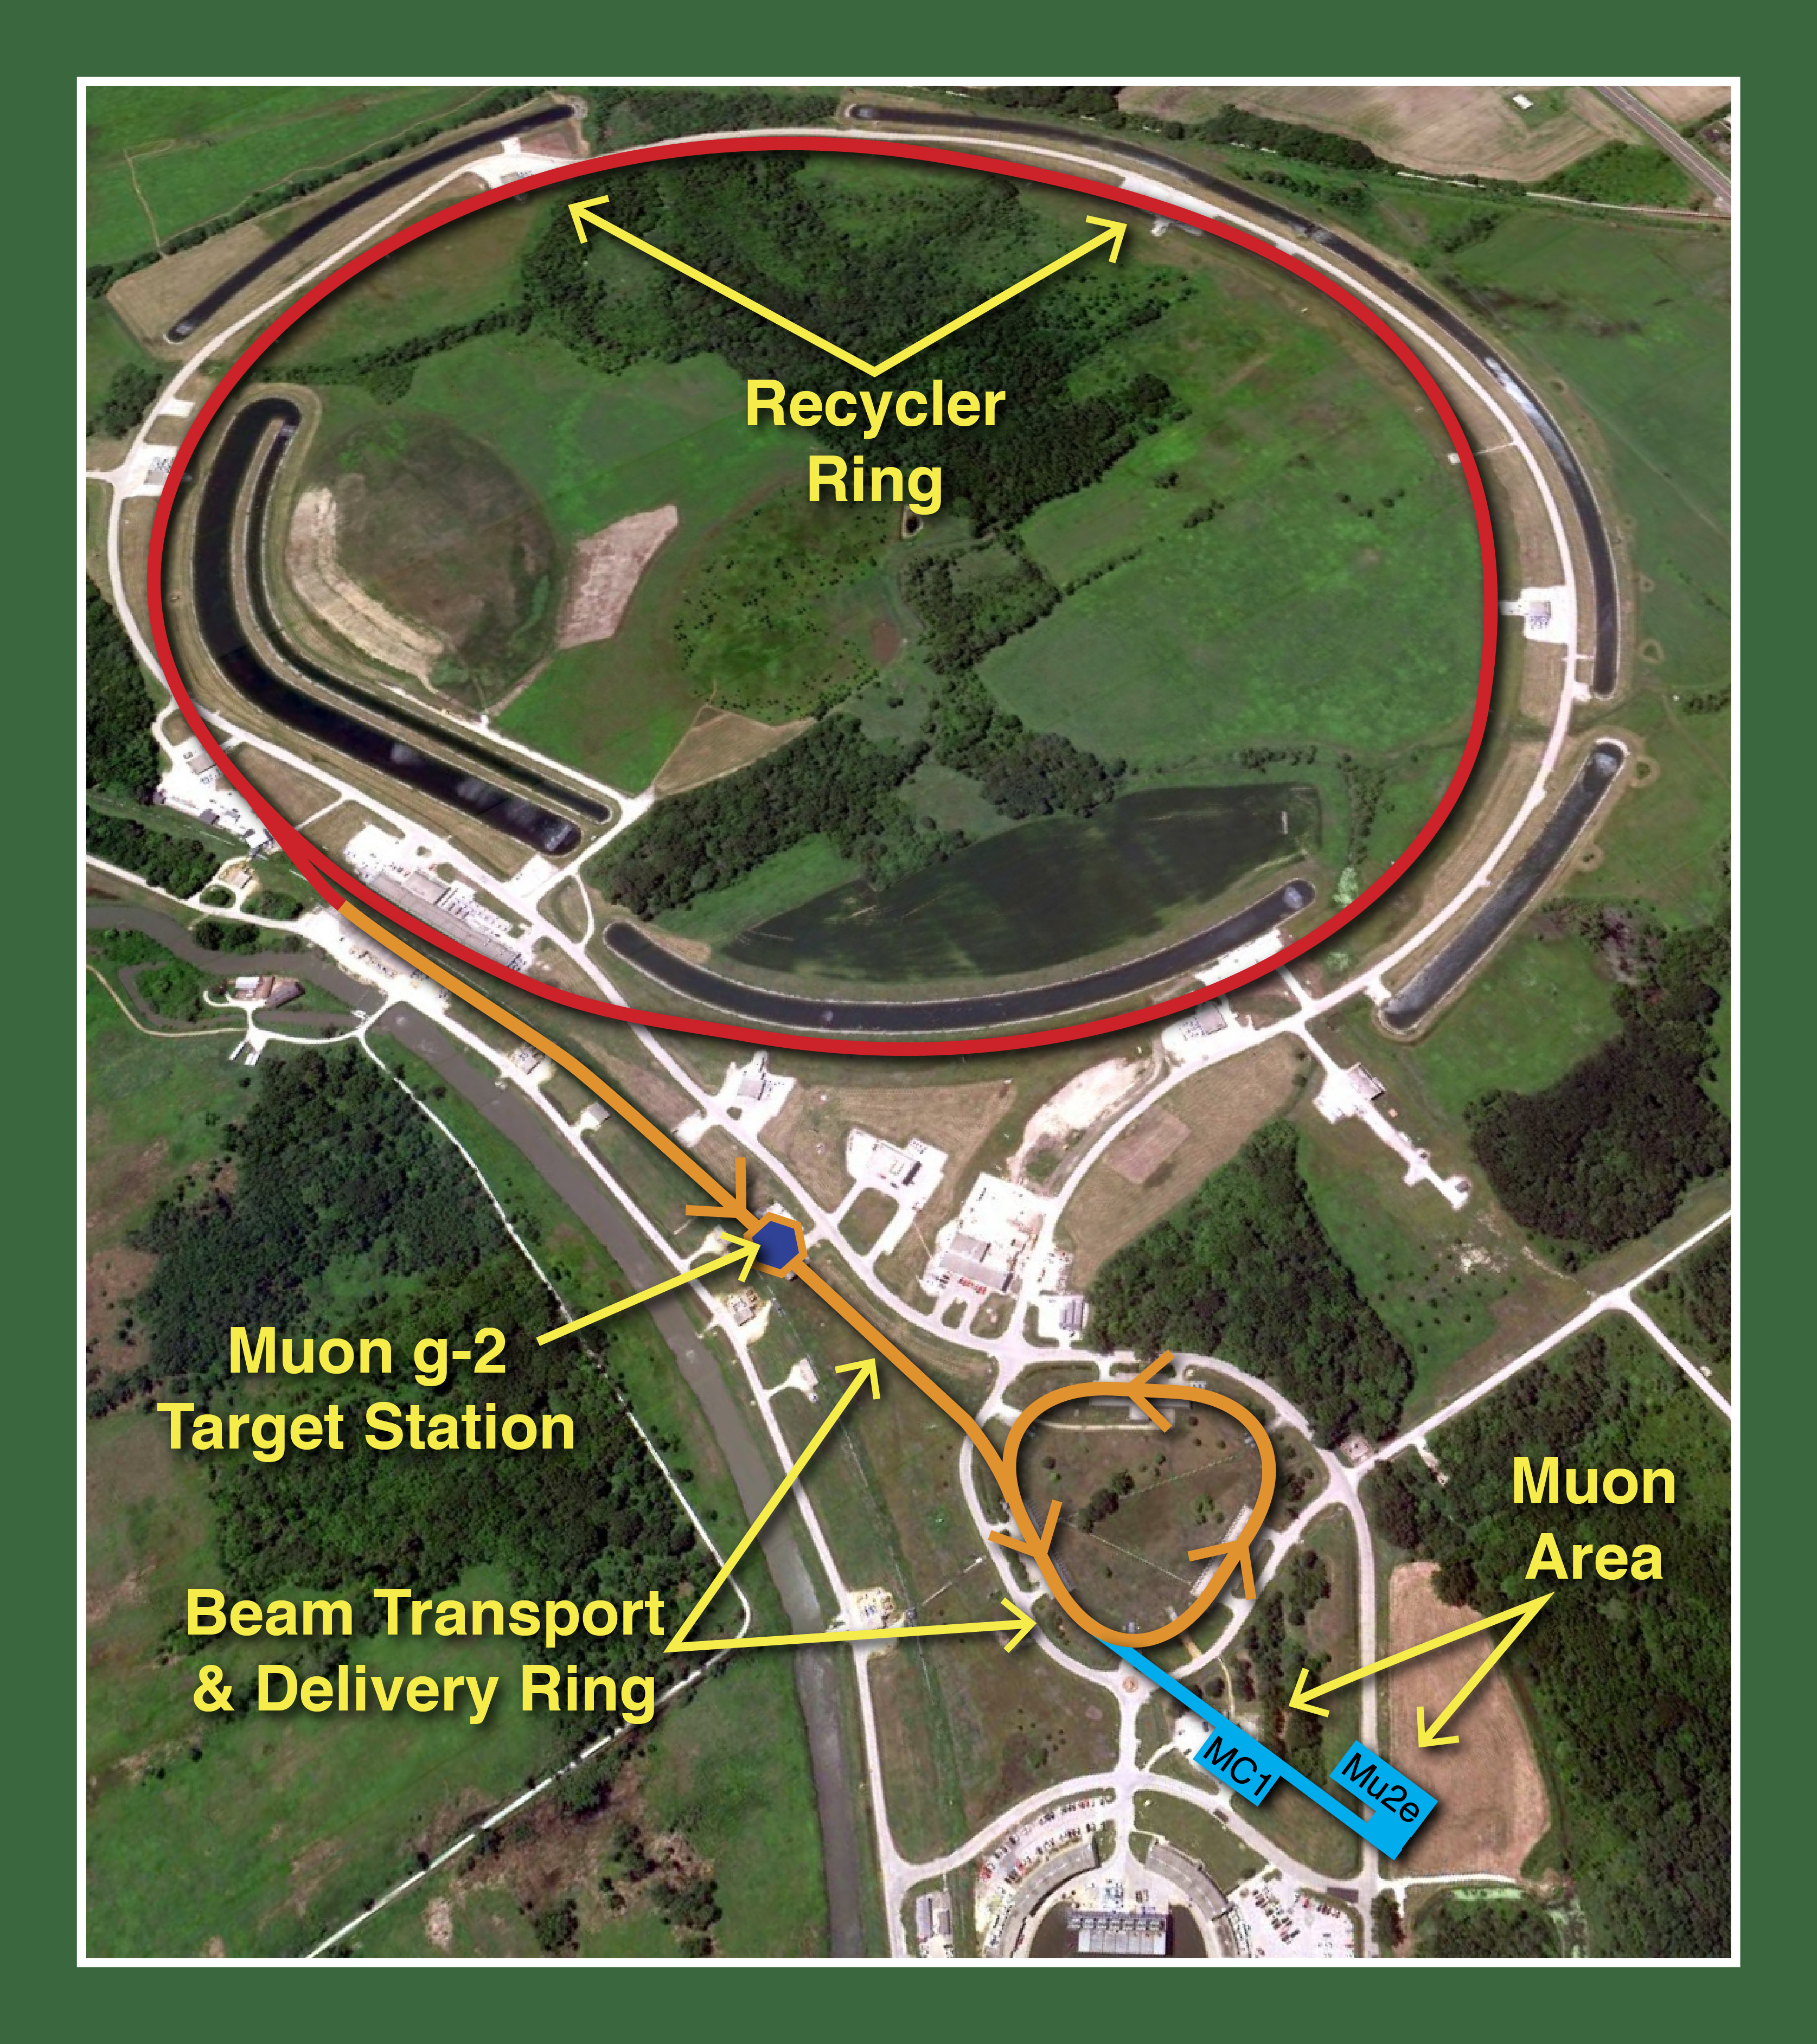
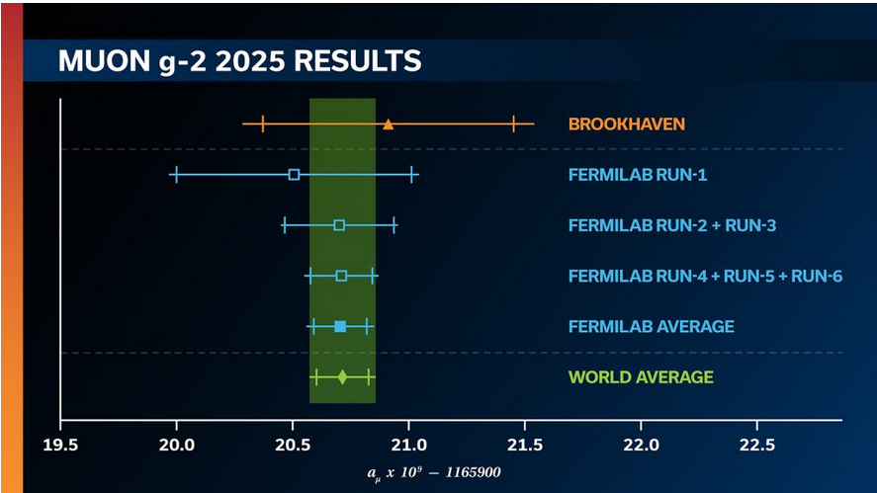
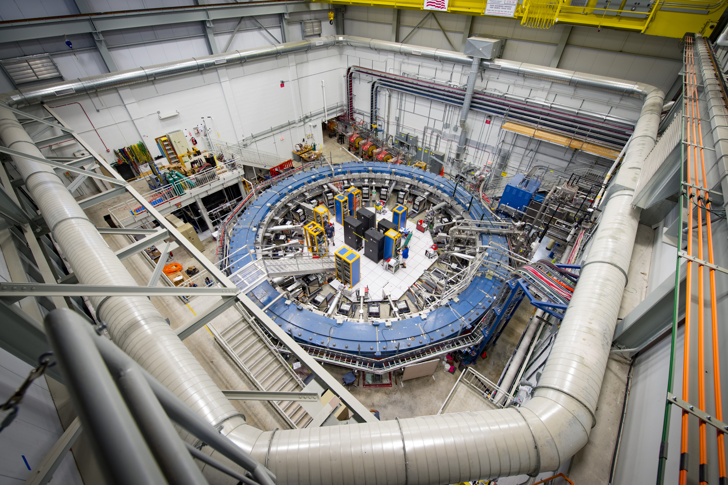
Muon g-2 Experiment
Muon g-2 run has ended
Final data has provided a measurement with a precision of 127 parts per billion

Slide 10
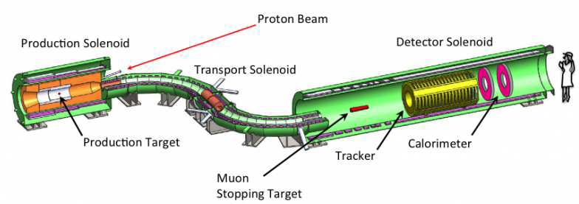
Mu2e Experiment
Mu2e installation and commissioning over the next year with some run time expected before the long shutdown for PIP-II installation
A second run will follow PIP-II installation, starting in 2030/31.
Poster 22

Slide 11
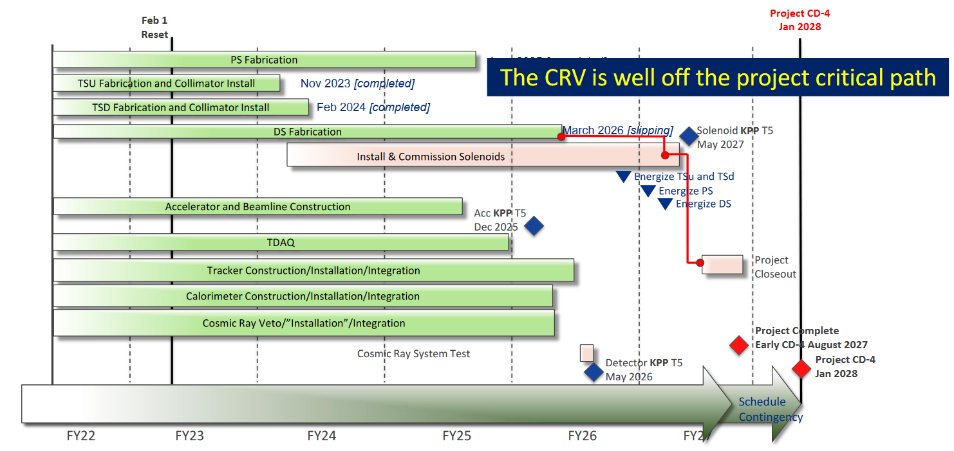
Mu2e Experiment

Slide 12
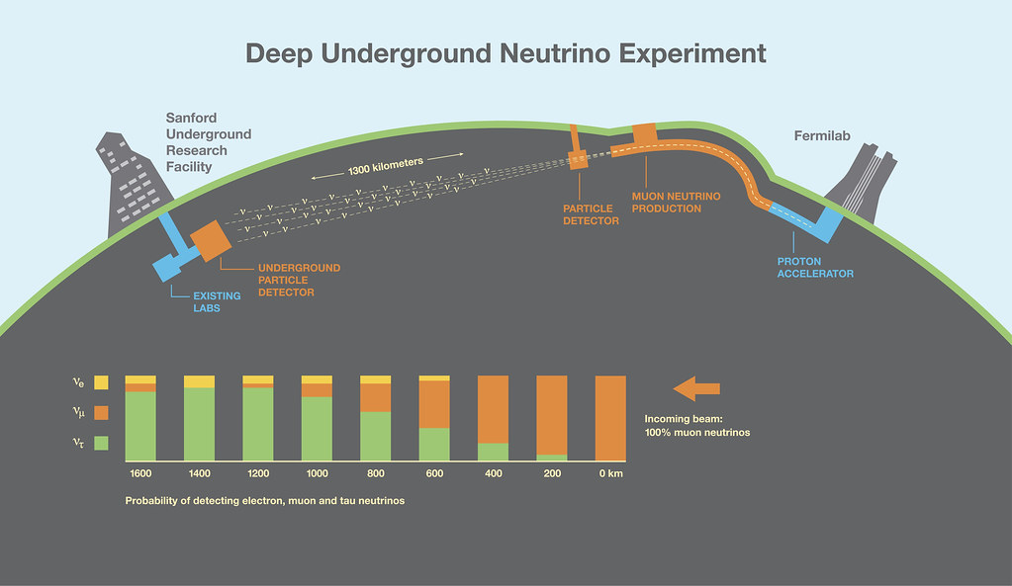
LBNF - DUNE

Slide 13
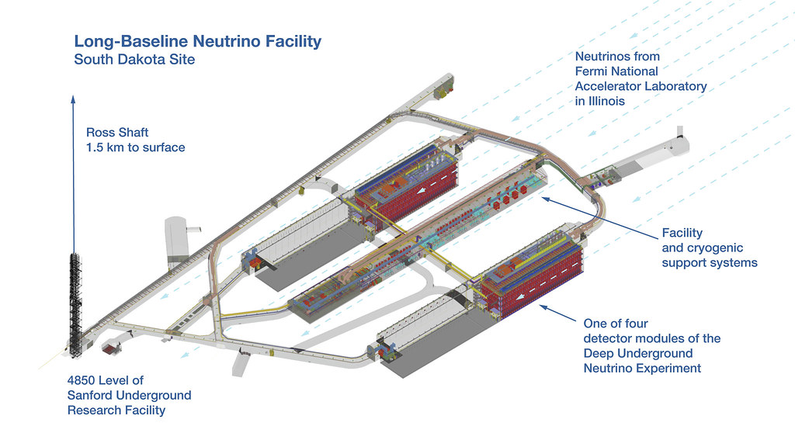
LBNF - DUNE

Slide 14
Thank You !

